Slide 1

Geocaching Merit Badge
Troop 344 and 9344
Pemberville, OH

Slide 2
Geocaching Merit Badge Requirements
Do the following:
  Explain to your counselor the most likely hazards you may encounter while participating in geocaching activities and what you should do to anticipate, help prevent, mitigate, and respond to these hazards.
  Discuss first aid and prevention for the types of injuries or illnesses that could occur while participating in geocaching activities, including cuts, scrapes, snakebite, insect stings, tick bites, exposure to poisonous plants, heat and cold reactions (sunburn, heatstroke, heat exhaustion, hypothermia), and dehydration.
  Discuss how to properly plan an activity that uses GPS, including using the buddy system, sharing your plan with others, and considering the weather, route, and proper attire.
Discuss the following with your counselor:
  Why you should never bury a cache.
  How to use proper geocaching etiquette when hiding or seeking a cache, and how to properly hide, post, maintain, and dismantle a geocache
  The principles of Leave No Trace as they apply to geocaching

Slide 3
Geocaching Merit Badge Requirements
Explain the following terms used in geocaching: waypoint, log, cache, accuracy, difficulty and terrain ratings, attributes, trackable. Choose five additional terms to explain to your counselor.
Explain how the Global Positioning System (GPS) works. Then, using Scouting's teaching EDGE, demonstrate the use of a GPS unit to your counselor. Include marking and editing a waypoint, changing field functions, and changing the coordinate system in the unit.
Do the following:
  Show you know how to use a map and compass and explain why this is important for geocaching.
  Explain the similarities and differences between GPS navigation and standard map reading skills and describe the benefits of each.

Slide 4
Geocaching Merit Badge Requirements
Describe the four steps to finding your first cache to your counselor. Then mark and edit a waypoint.
With your parent's permission*, go to www.geocaching.com. Type in your city and state to locate public geocaches in your area. Share the posted information about three of those geocaches with your counselor. Then, pick one of the three and find the cache.
*To fulfill this requirement, you will need to set up a free user account with www.geocaching.com. Ask your parent for permission and help before you do so.

Slide 5
Geocaching Merit Badge Requirements
Do ONE of the following:
  If a Cache to Eagle® series exists in your council, visit at least three of the 12 locations in the series. Describe the projects that each cache you visit highlights, and explain how the Cache to Eagle® program helps share our Scouting service with the public.
  Create a Scouting-related Travel Bug® that promotes one of the values of Scouting. "Release" your Travel Bug into a public geocache and, with your parent's permission, monitor its progress at www.geocaching.com for 30 days. Keep a log, and share this with your counselor at the end of the 30-day period.
  Set up and hide a public geocache, following the guidelines in the Geocaching merit badge pamphlet. Before doing so, share with your counselor a three-month maintenance plan for the geocache where you are personally responsible for those three months. After setting up the geocache, with your parent’s permission, follow the logs online for 30 days and share them with your counselor. You must archive the geocache when you are no longer maintaining it.
  Explain what Cache In Trash Out (CITO) means, and describe how you have practiced CITO at public geocaches or at a CITO event. Then, either create CITO containers to leave at public caches, or host a CITO event for your unit or for the public.
Plan a geohunt for a youth group such as your troop or a neighboring pack, at school, or your place of worship. Choose a theme, set up a course with at least four waypoints, teach the players how to use a GPS unit, and play the game. Tell your counselor about your experience, and share the materials you used and developed for this event.

Slide 6
Requirement 1
Do the following:
  Explain to your counselor the most likely hazards you may encounter while participating in geocaching activities and what you should do to anticipate, help prevent, mitigate, and respond to these hazards.
  Discuss first aid and prevention for the types of injuries or illnesses that could occur while participating in geocaching activities, including cuts, scrapes, snakebite, insect stings, tick bites, exposure to poisonous plants, heat and cold reactions (sunburn, heatstroke, heat exhaustion, hypothermia), and dehydration.
  Discuss how to properly plan an activity that uses GPS, including using the buddy system, sharing your plan with others, and considering the weather, route, and proper attire.

Slide 7
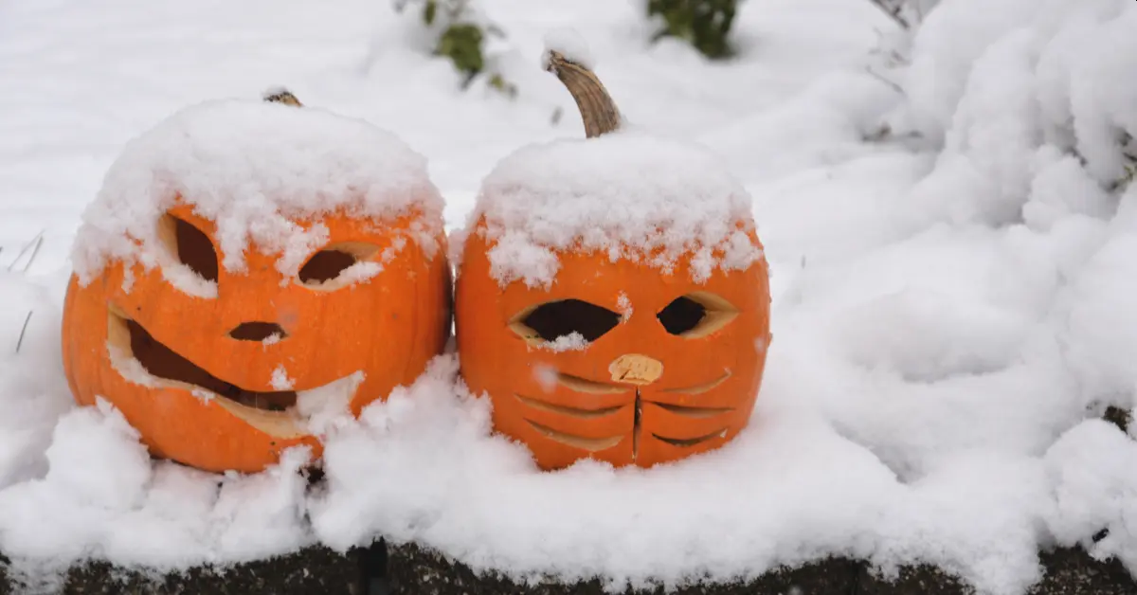
1a Hazards
The most typical hazards you’ll encounter while geocaching are:
  Unexpected Weather Conditions
  Insect Bites/Stings
  Dangerous Wild Animals
  Excessive Rain/Flooding
  Heat-Related Injuries
Many of these issues can be prevented by being prepared in your packing and can be responded to by removing the affected person from the hazardous environment, then treating them accordingly.

Slide 8

Geocaching and the Internet
Several websites offer information about geocaching. Just remember that no one controls the information put on the web. What you see posted may be incorrect or misleading. Always consider the source of the information to help you evaluate how accurate it might be.
Basic Internet Safety:
Follow your family’s rules for going online. Obey time limits and do not visit areas that are off-limits.
Protect your privacy. Never exchange e-mails, give out personal information, or send your picture without your parent’s permission
Do not open e-mails or files your receive from people you don’t know or trust. Delete suspicious items.
If you receive or discover any information that makes you uncomfortable, leave it and tell your parents. Do not respond to any message that is disturbing or hurtful.

Slide 9

Geocaching and the Internet
Basic Internet Safety (continued):
Never agree to get together with someone you “meet” online, unless your parents approve of the meeting and goes with you.
Never share your internet passwords with anyone (even if they sound “official”) other than your parents or other responsible adults in your family.
Never shop online unless you have your parent’s permission to do so.
Do not believe everything you see or read online. Along with lots of great information, the internet has lots of junk. Learn to separate the useful from the useless.
Be a good online citizen. Do not do anything that harms others or is against the law.

Slide 10
Requirement 1
Do the following:
  Explain to your counselor the most likely hazards you may encounter while participating in geocaching activities and what you should do to anticipate, help prevent, mitigate, and respond to these hazards.
  Discuss first aid and prevention for the types of injuries or illnesses that could occur while participating in geocaching activities, including cuts, scrapes, snakebite, insect stings, tick bites, exposure to poisonous plants, heat and cold reactions (sunburn, heatstroke, heat exhaustion, hypothermia), and dehydration.
  Discuss how to properly plan an activity that uses GPS, including using the buddy system, sharing your plan with others, and considering the weather, route, and proper attire.

Slide 11
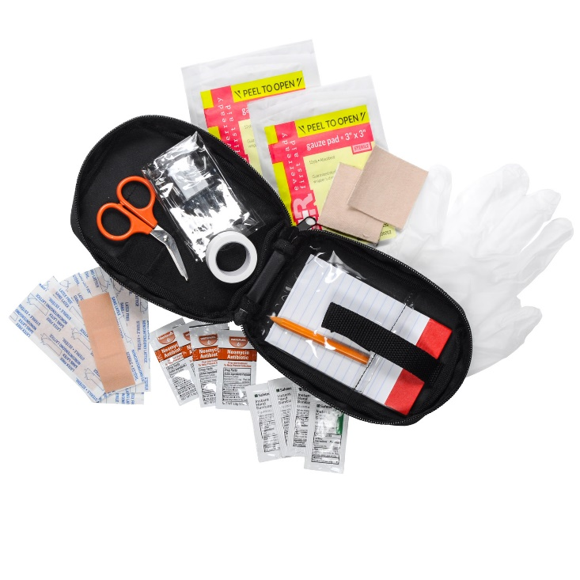
Personal First-Aid Kit
The items you carry in your personal first-aid kit will handle most of the medical problems you are likely to encounter while geocaching.
Adhesive bandages (6)
Sterile gauze pads, 3”x3” (2)
Adhesive tape (1 small roll)
Moleskin, 3”x6” (1)
Hand sanitizing gel (1 travel size bottle)
Triple antibiotic ointment (1 small tube)
Scissors
Nonlatex disposable gloves (1 pair)
Mouth barrier device
Pencil and paper

Slide 12
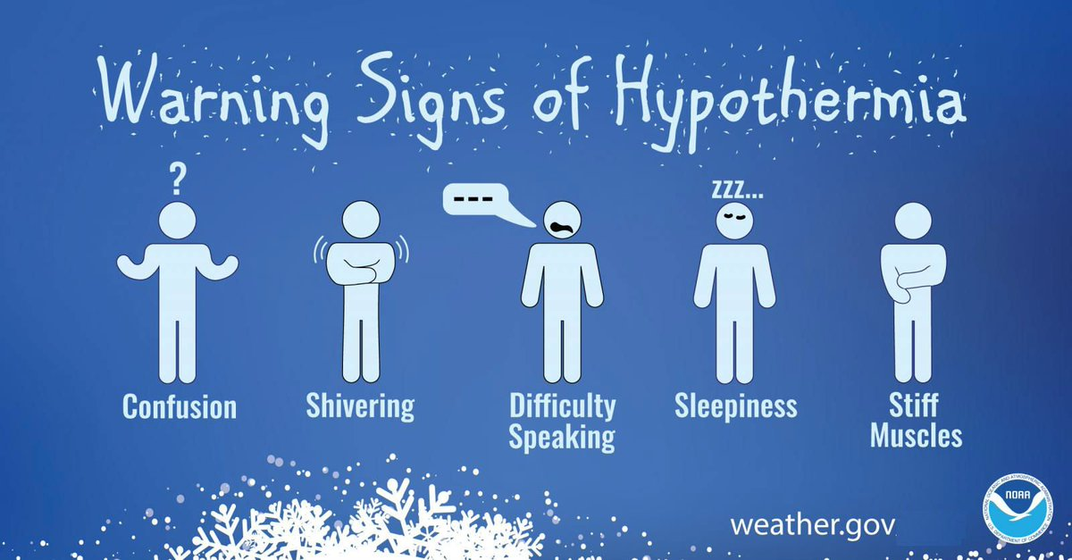
Hypothermia
Occurs when body cannot make heat as fast as it loses it.
Internal body temperature drops below 95ºF.
Can occur whenever and wherever a person feels cold, including indoors in poorly heated areas.

Slide 13
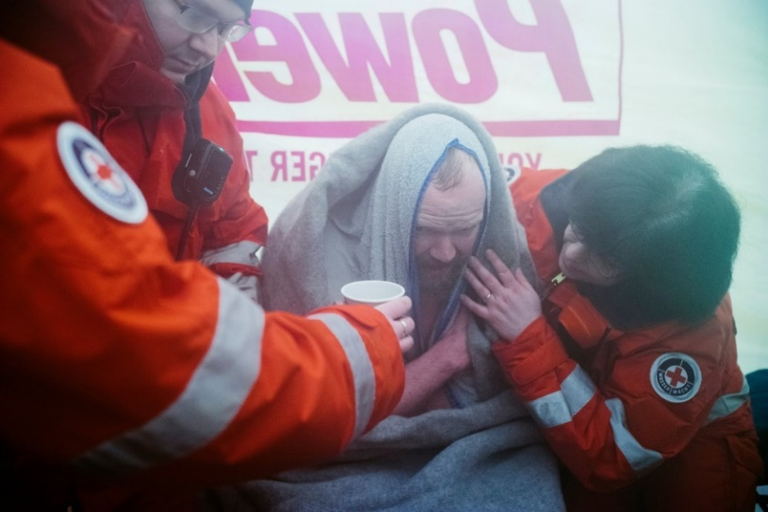
Hypothermia
Move victim to shelter.
Remove wet clothing and wrap victim in warm covers.
Apply direct body heat.
Re-warm neck, chest, abdomen, and groin first.
Give warm, sweet drinks if conscious.
Monitor breathing, administer CPR.
Get medical help.

Slide 14
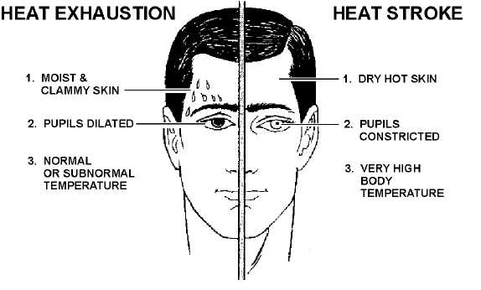
Heat Reactions

Slide 15
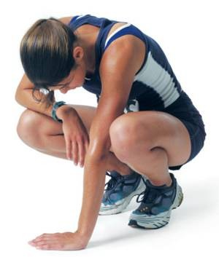
Heat Exhaustion Symptoms
Heavy sweating
Thirst
Fatigue
Heat cramps
Headache
Dizziness
Nausea
Vomiting

Slide 16

First Aid for Heat Exhaustion
Move victim from heat to rest in a cool place.
Loosen or remove unnecessary clothing.
Give water or a sports drink.
Raise feet 8-12 inches.
Put cool, wet cloths on forehead and body – spray skin with water.
Seek medical care if victim’s condition worsens or does not improve within 30 minutes.

Slide 17
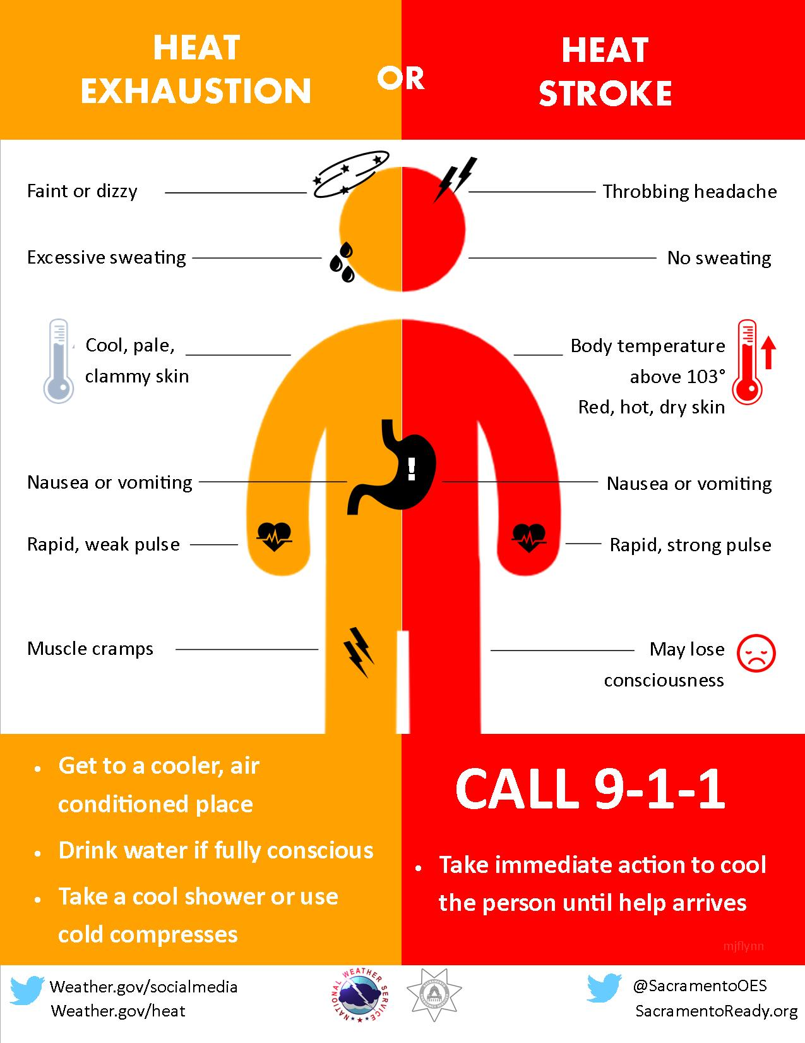
Heatstroke

Slide 18
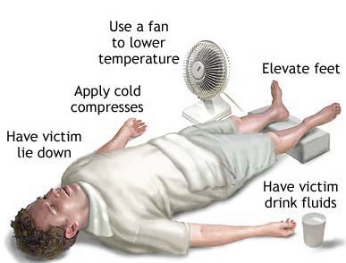
First Aid for Heat Stroke
Call 911.
Move victim to cool place.
Remove outer clothing.
Cool victim quickly.
Apply cold compresses or spray skin with water.
Put ice bags or cold packs beside neck, armpits, and groin.

Slide 19

Dehydration
When the body puts out more liquid than it is taking in.
Ways we lose fluids:
  Sweating.
  Urination.
  Vomiting.
Signs of dehydration:
  Thirst.
  Yellow or dark urine.
  Dry mouth.
  Lightheadedness.
  Nausea and vomiting.
  Dry skin.
  Cease sweating.
Treatment:
  Drink fluids (water, Gatorade).
  Avoid physical activity.
  Get inside air conditioned or cool area.

Slide 20
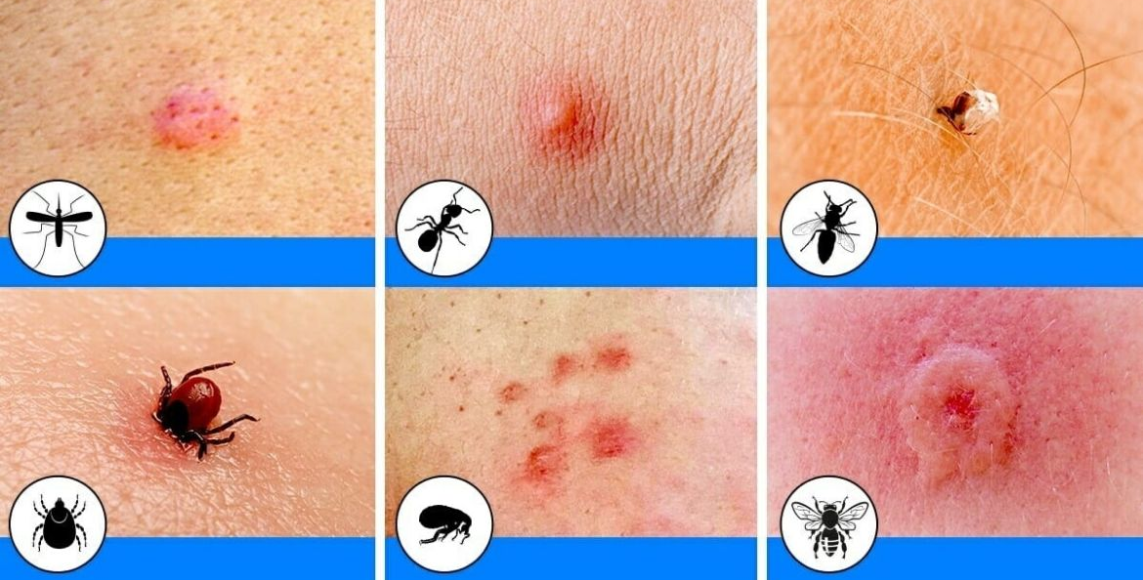
Insect Bites
Bites of mosquitoes and chiggers (harvest mites usually cause itchy, red bumps. The size of the swelling can vary from a dot to a half inch.
Signs that a bite is from a mosquito are: itchiness, a central raised dot in the swelling, a bite on skin not covered by clothing, and summertime,
Bites from horseflies, deerflies, gnats, fire ants, harvester ants, blister beetles, and centipedes usually cause a painful, red bump.
Fire ant bites change to blisters or pimples within a few hours.

Slide 21

Treatment of Insect Bites
Apply calamine lotion or a baking soda paste to the area of the bite.
If the itch is severe (as with chiggers), apply nonprescription 1% hydrocortisone cream four times a day.
Do not to pick at the bites or they can become infected or leave scars.
Cold, moist compresses or ice on the area can help.

Slide 22
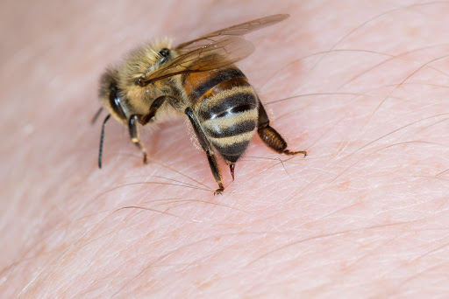
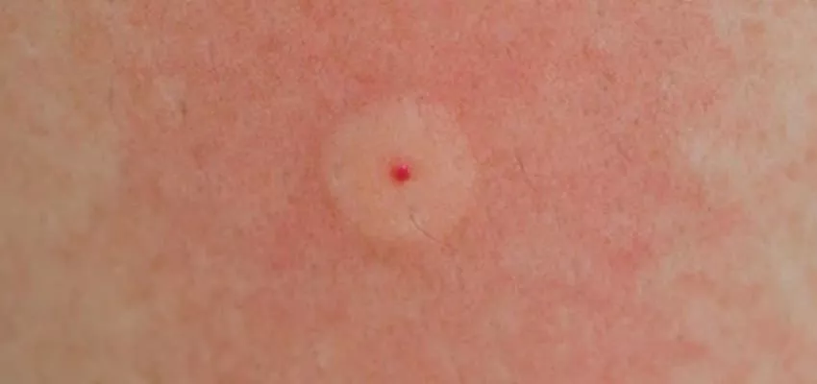
Bee Stings
Honey bees, bumble bees, hornets, wasps, and yellow jackets can all sting.
These stings cause immediate painful red bumps.
While the pain is usually better in 2 hours, the swelling may increase for up to 24 hours.

Slide 23
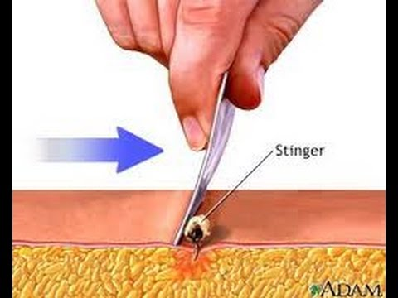
Treatment of Bee Stings
If you see a little black dot in the bite, the stinger is still present (this only occurs with honey bee stings).
Remove it by scraping it off with a credit card or something similar.
For persistent pain, massage with an ice cube for 10 minutes.
Give acetaminophen immediately for relief of pain and burning.
For itching, apply hydrocortisone cream.

Slide 24
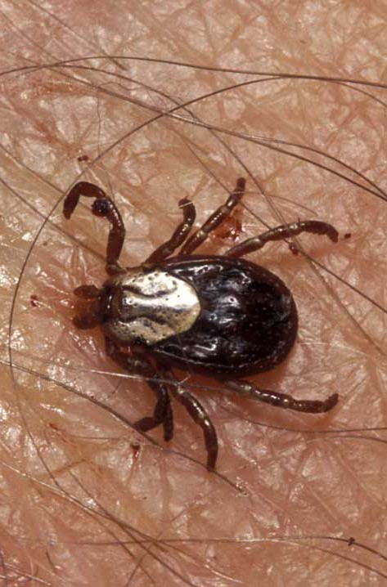
Tick Bites
Can transmit Rocky Mountain spotted fever or Lyme disease.
Tick embeds its mouth parts in skin and may remain for days sucking blood.

Slide 25
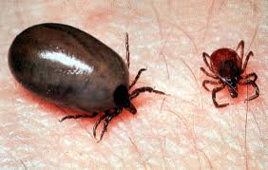
Engorged Tick

Slide 26
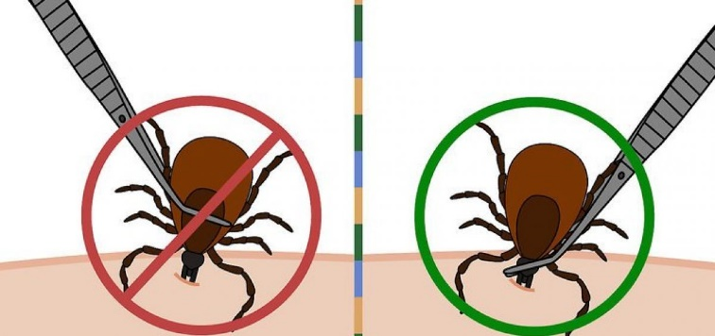
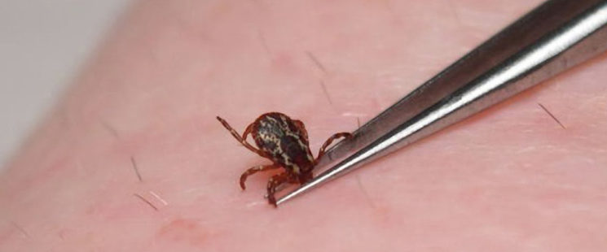
Tick Removal
Grasp the tick’s mouthparts against the skin, using pointed tweezers.
Pull steadily without twisting until you can ease the tick head straight out of the skin.
DO NOT squeeze or crush the body of the tick.
DO NOT apply substances such as petroleum jelly, nail polish, or a lighted match to the tick while it is attached.

Slide 27
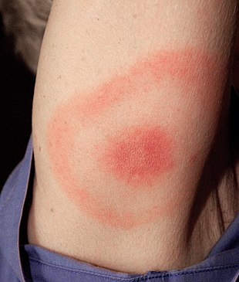
Tick Removal (cont.)
Once you have removed the tick, wash the wound site and your hands with soap and water, and apply rubbing alcohol or antiseptic to the site.
Observe the bite over the next two weeks for any signs of an expanding red rash or flu-like symptoms (Lyme Disease).
Lyme Disease Rash

Slide 28

Poisonous Plants
Can you identify and name them?

Slide 29
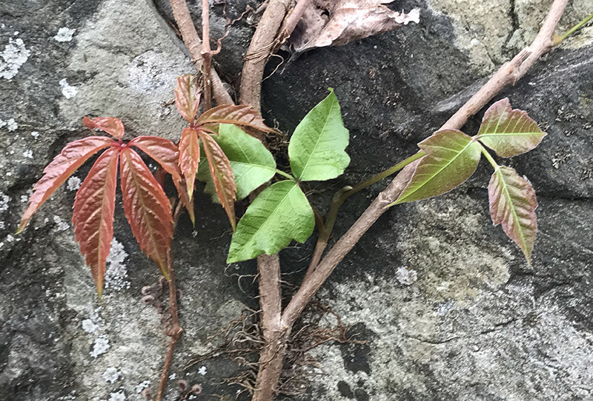
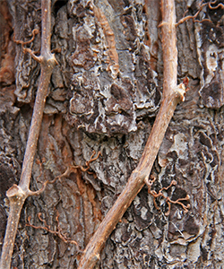
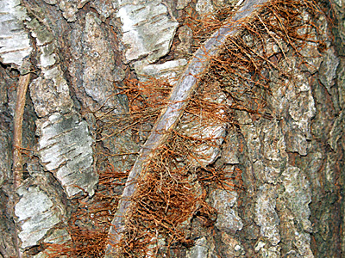
Identify Local Poisonous Plants
Virginia Creeper is sometimes mistaken for poison ivy.
The leaves and vines on the left are Virginia Creeper and those on the right are Poison Ivy.

Slide 30
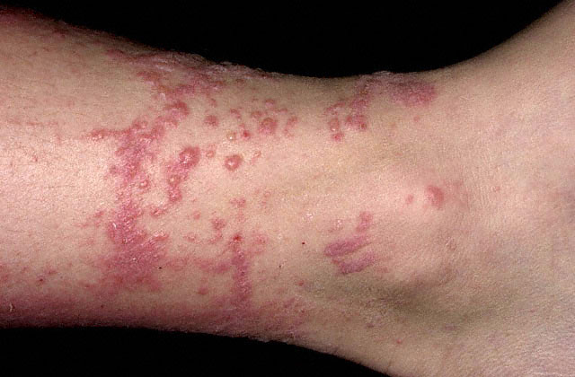
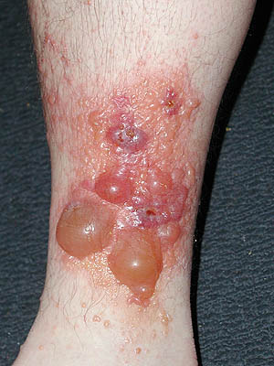
Poison Ivy Rash
Average Case
Severe Case

Slide 31
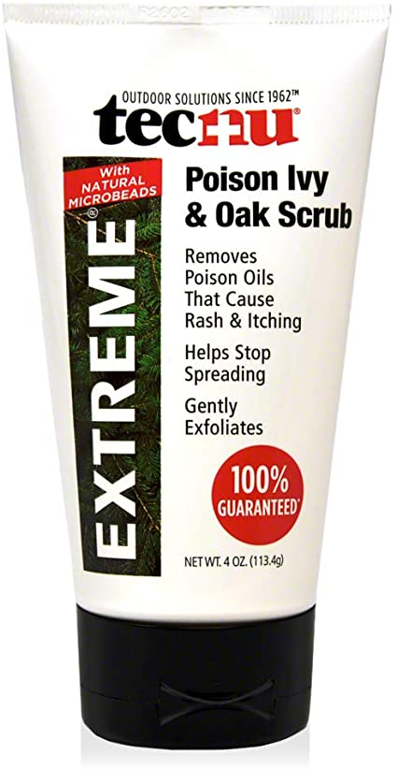
Treating Poison Ivy Exposures
If you are exposed you should quickly (within 10 minutes):
      Clean exposed areas with rubbing alcohol.
      Wash the exposed areas with water only first.
      Then take a shower with soap and warm water.
Tecnu is a poison oak and ivy scrub that removes urushiol.
Unfortunately, if you wait more than 10 minutes, the urushiol will likely stay on your skin and trigger the poison ivy rash.

Slide 32
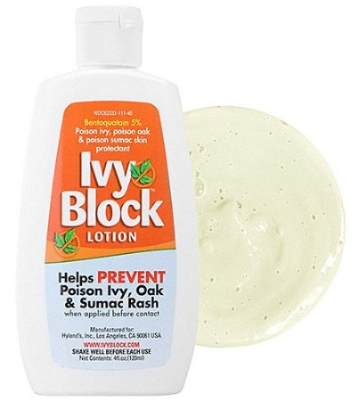
Preventing Poison Ivy
The best way to prevent Poison Ivy is learn to identify it and then avoid it!
You can avoid a poison ivy rash by:
  Wearing long pants and a shirt with long sleeves.
  Boots and gloves when your most at risk, especially when playing in wooden areas, around lakes, or going on hikes.
  Apply Ivy-Block to exposed skin.

Slide 33
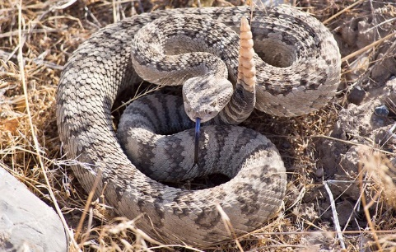
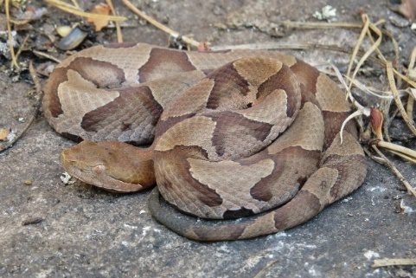
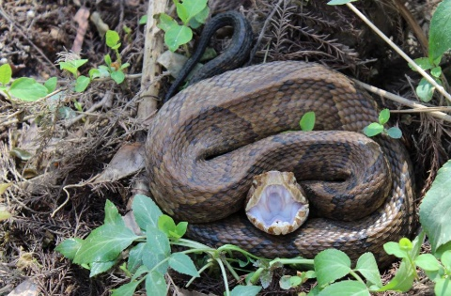
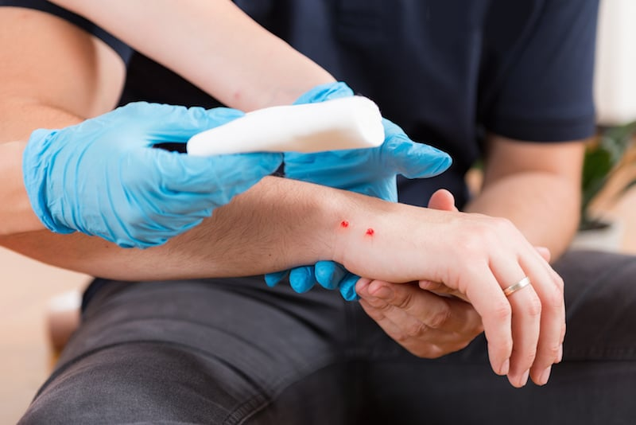
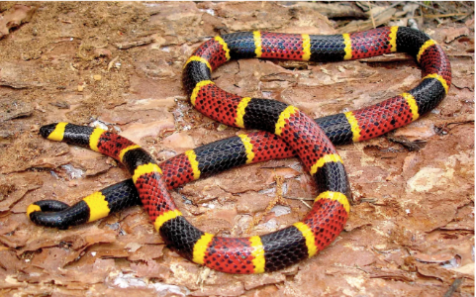
Poisonous Snakebite
In the U.S. the poisonous snakes are rattlesnakes, copperheads, cottonmouths, and coral snakes.
Currently about 8,000 people per year in the U.S. are bitten by a poisonous snake, of which about 6 will die.

Slide 34
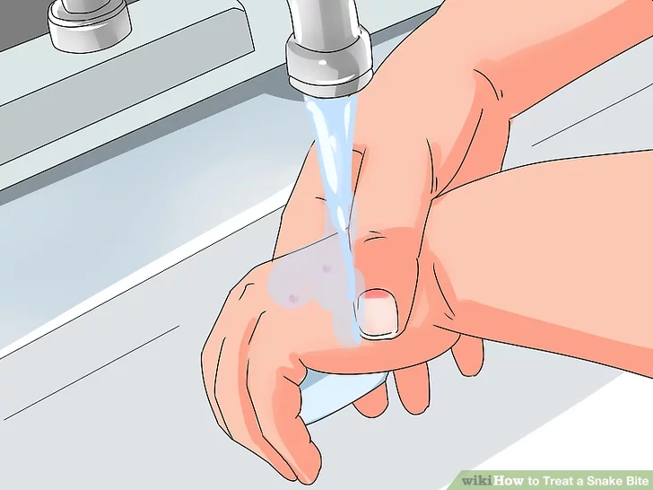
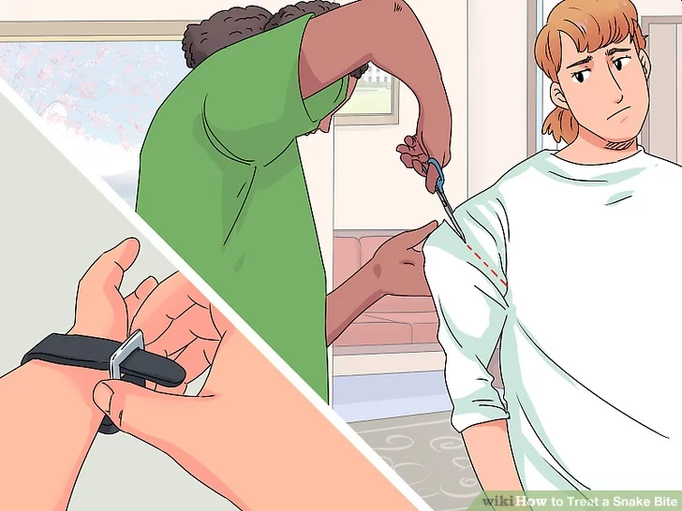
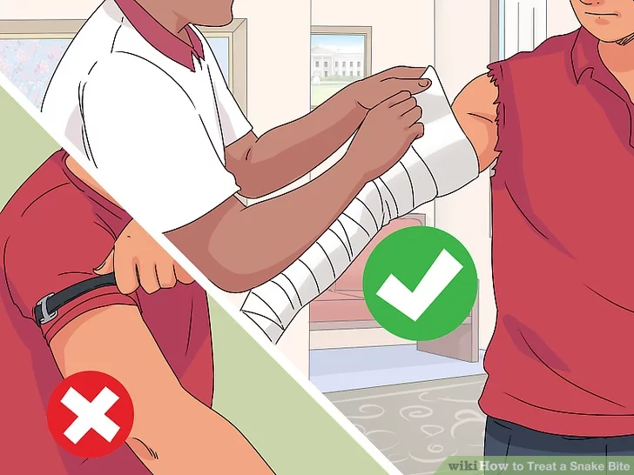
First Aid for Poisonous Snake Bites
Have victim lie down and stay calm.
Keep bitten area immobile and below level of heart.
Call 911.
Wash bite wound with soap and water.
Remove jewelry or tight clothing before swelling.
Do not try to catch snake but note appearance.
If possible, wrap entire extremity with elastic (compression) bandage to slow spread of venom.
Do not use a tourniquet.
Do not cut wound open to try to drain or suck venom out.

Slide 35
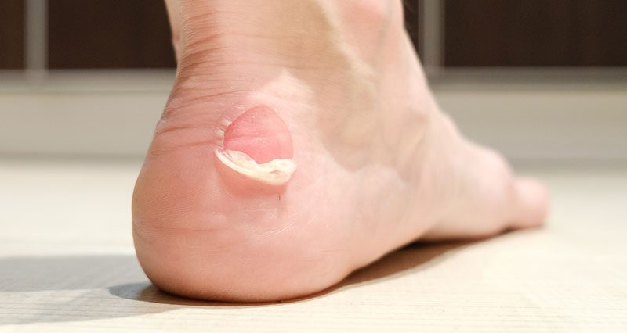
Blisters
A blister is skin injury that is usually filled with water.
Blisters commonly occur on the feet or hands.
They are most often caused by the hands or feet rubbing against something (such as wearing new shoes).

Slide 36
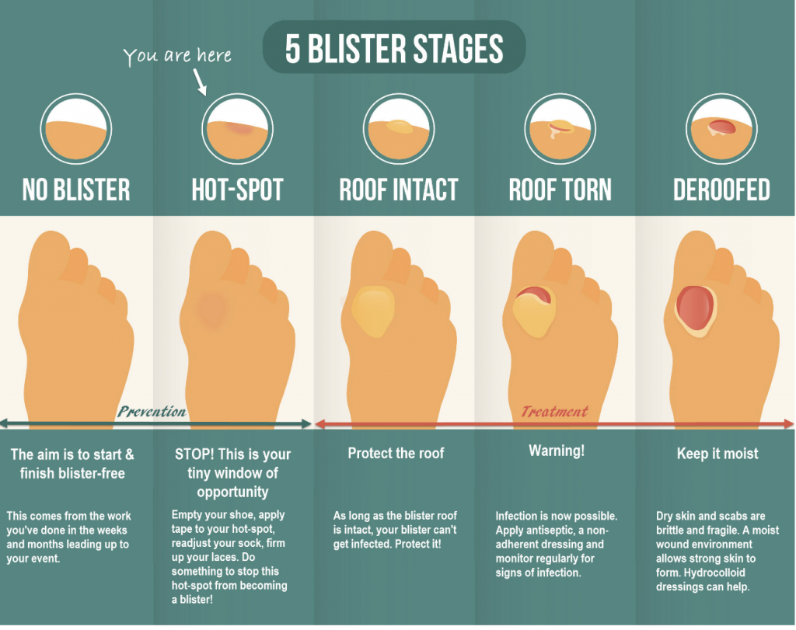

Slide 37
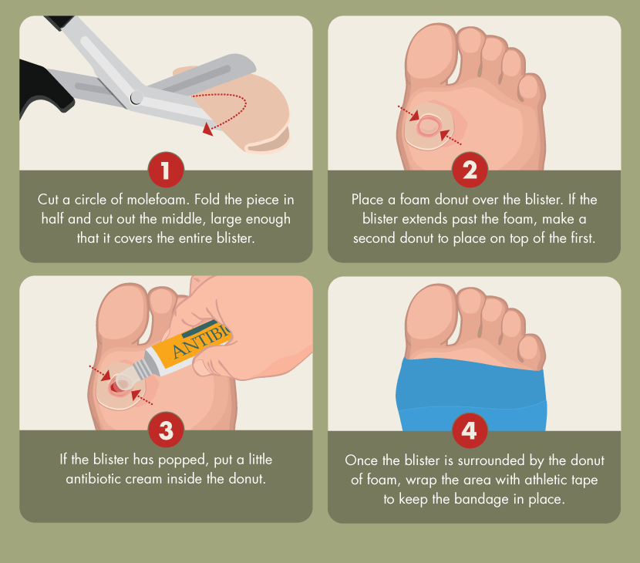
Treatment for Blisters
Do not open the blisters, since this increases the possibility of infection.
Clean the skin around it.
Take the pressure off the area by placing a Band-Aid over the blister or Moleskin with a hole cut in the center.
If the blister accidentally breaks open, trim off the loose skin.
Keep the surface clean by washing it twice a day with an antibacterial soap (such as Dial or Safeguard).
Apply an antibiotic ointment and a Band-Aid to help with healing.

Slide 38
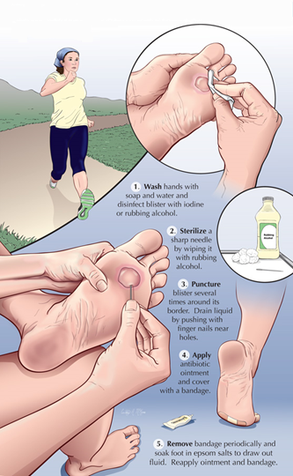
Popping a Blister
If a blister is in a frequently used area that has a high risk of rupturing, it may be best to pop it to make sure it’s properly protected against infection.
Wash your hands and the blister thoroughly.
Disinfect a needle with alcohol.
Carefully puncture the blister.
  Poke three or four shallow holes around the edge of the blister.
  You want to keep as much of the skin intact as possible.
  Allow the fluid to drain out.
Cover the blister with a first aid ointment such as Neosporin.
Apply a dressing.
  Cover the blister tightly with a bandage or gauze.
Repeat if necessary.
  You may need to perform these steps every six to eight hours for the first 24 hours.
  After that, change the dressing and apply ointment daily.

Slide 39
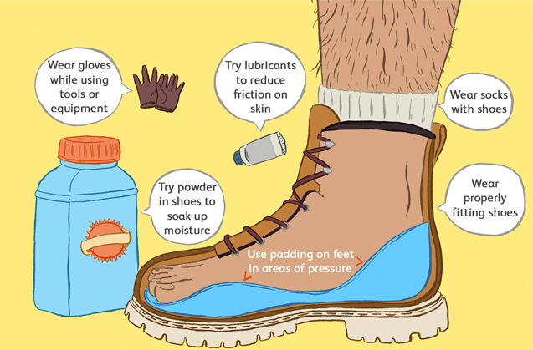
Preventing Blisters
Friction can also be reduced by wearing two pairs of socks.
Place Moleskin on sensitive areas were the friction may occur.

Slide 40
Requirement 1
Do the following:
  Explain to your counselor the most likely hazards you may encounter while participating in geocaching activities and what you should do to anticipate, help prevent, mitigate, and respond to these hazards.
  Discuss first aid and prevention for the types of injuries or illnesses that could occur while participating in geocaching activities, including cuts, scrapes, snakebite, insect stings, tick bites, exposure to poisonous plants, heat and cold reactions (sunburn, heatstroke, heat exhaustion, hypothermia), and dehydration.
  Discuss how to properly plan an activity that uses GPS, including using the buddy system, sharing your plan with others, and considering the weather, route, and proper attire.

Slide 41
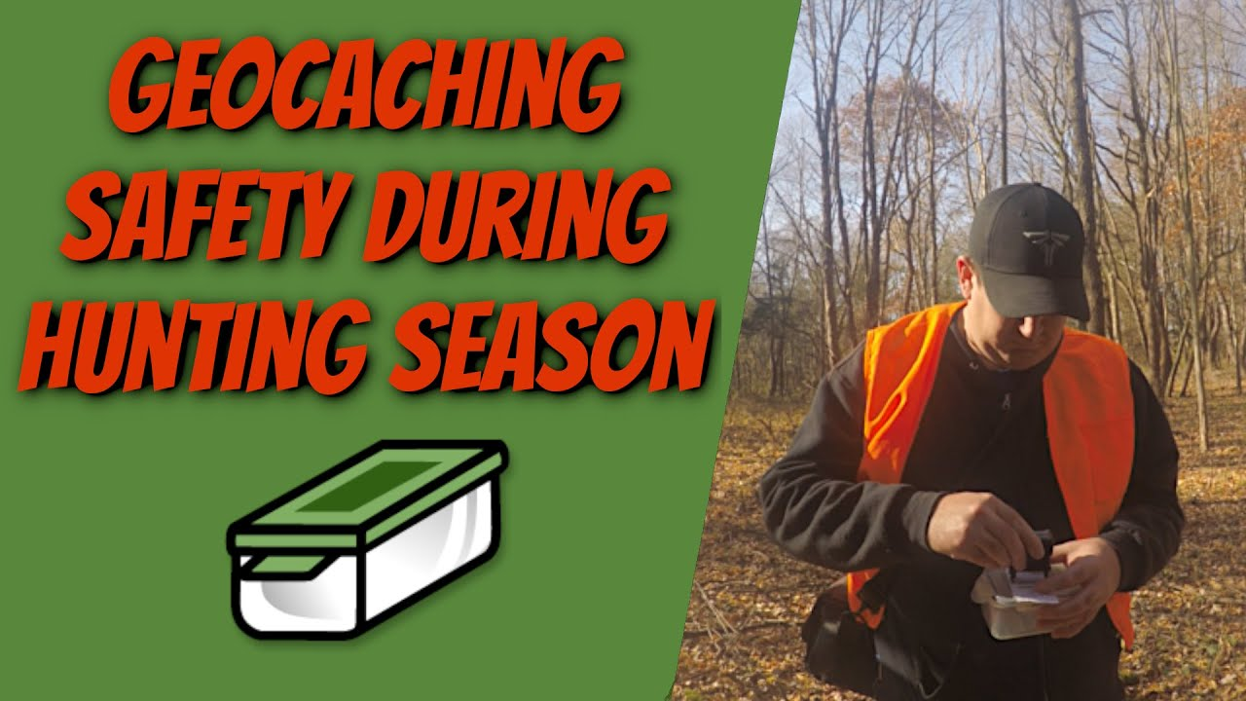
Managing Risk
Use the buddy system
  When you geocache with a buddy, you watch out for each other.
Plan ahead
  Know where you are going and what to expect on the trip.
  Tell someone where you are going and when you expect to return.
  Pack your pack by bringing a personal first-aid kit, a compass, maps, extra batteries for your GPS receiver, water, food, and extra clothing.
Watch the weather
  Avoid dangerous weather situations such as lightning storms.
  Dress appropriately for the weather conditions and take plenty of water.

Slide 42
Requirement 2
Discuss the following with your counselor:
  Why you should never bury a cache.
  How to use proper geocaching etiquette when hiding or seeking a cache, and how to properly hide, post, maintain, and dismantle a geocache.
  The principles of Leave No Trace as they apply to geocaching.

Slide 43
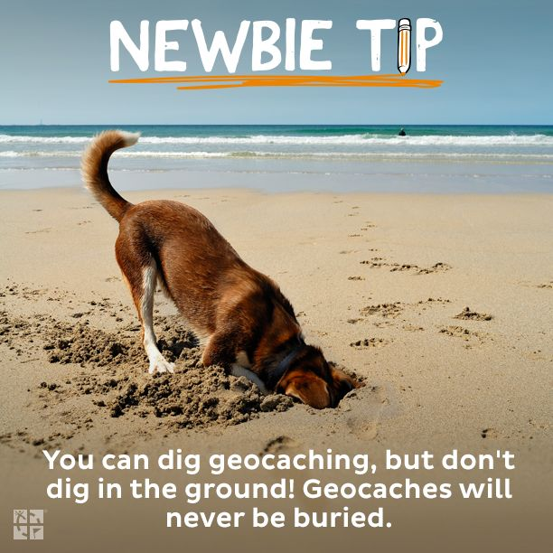
Never Bury a Cache
A cache should be well hidden, but not impossible to find.
You should never alter the environment when you hide a cache, nor should you place the cache in such a spot that seekers will have to affect the environment when they look for it.
Never bury a geocache or place it in thick brush that others will have to clear.
  Since the accuracy of a GPS receiver never gets you to the exact spot, too many holes would be dug searching for a buried container.
Burying a geocache violates the principles of “Leave No Trace.”

Slide 44
Requirement 2
Discuss the following with your counselor:
  Why you should never bury a cache.
  How to use proper geocaching etiquette when hiding or seeking a cache, and how to properly hide, post, maintain, and dismantle a geocache.
  The principles of Leave No Trace as they apply to geocaching.

Slide 45
Etiquette for Hiding or Seeking a Geocache
Practice Cache In Trash Out (CITO). Always carry a trash bag and remove litter along your route.
Follow Leave No Trace guidelines in the natural environment.
Be careful of the area around the cache – don’t trample the grounds, rip up sprinkler heads, etc., in your frenzy to find the cache.
Follow all laws and regulations. Never enter private property without permission.
Write an entry in the logbook at the cache.
Cache items are there for fun and for trade. Try to leave something of equal value to what you take for yourself.
Respect other visitors around the area.

Slide 46
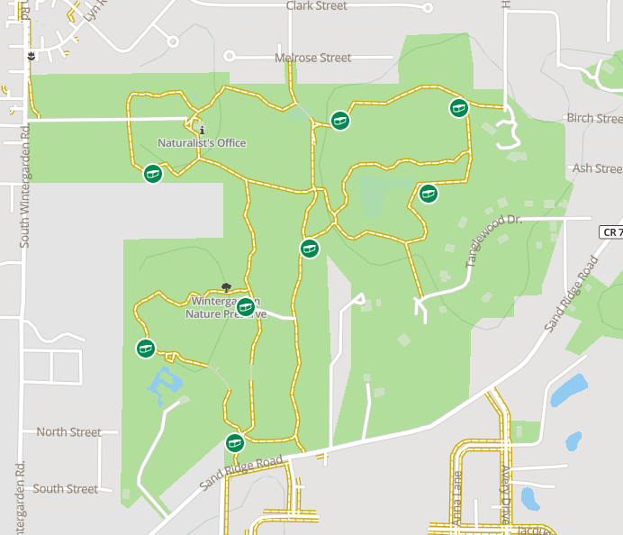
Four Steps of Hiding a Geocache
Research - Carefully research where you want to place your cache.
  Are there adequate places to hide your cache without risk to the environment when people are seeking them?
  Are there too many other caches nearby?
  Seek out new places to hide caches rather than put them where others already exist.

Slide 47
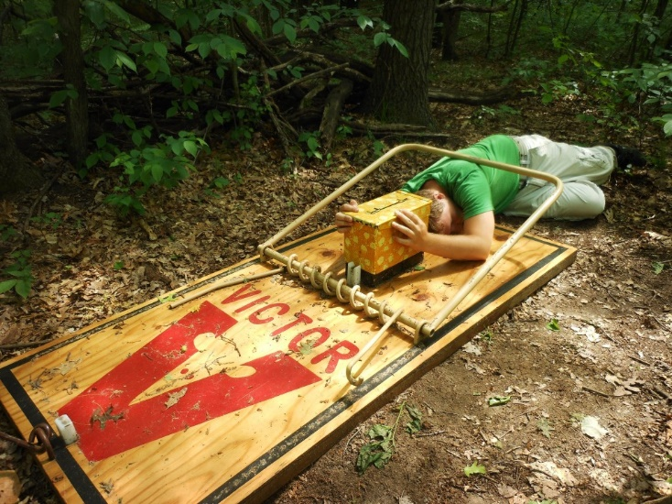
Four Steps of Hiding a Geocache
Safety – Your cache must be in a location that is safe to get to.
  Get permission from the landowner or land manager.
  Avoid placing caches anywhere the seekers might encounter danger (busy intersections, railroad tracks, electric utility boxes, high in trees, areas overgrown with poison ivy, giant mousetraps, etc.)
Questionable Hides

Slide 48
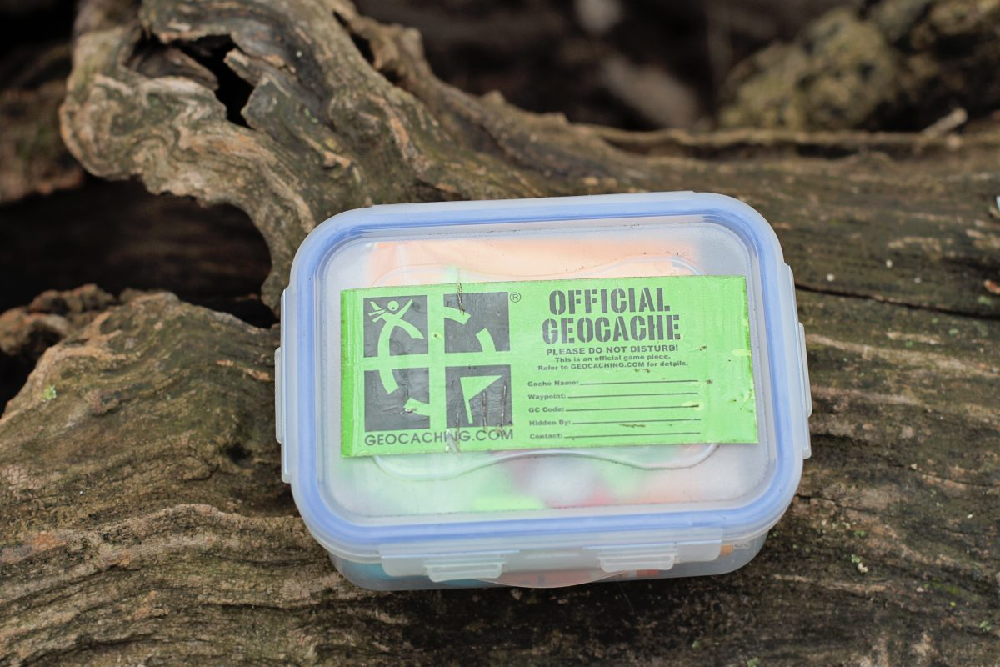
Four Steps of Hiding a Geocache
The Hunt – Make sure geocachers can find your cache.
  When placing the cache, can you get a good satellite signal.
  Make sure your cache can easily be identified as a geocache by writing “Geocache” on the outside of the container.
  Consider using a clear plastic container so the contents are easily identifiable.

Slide 49
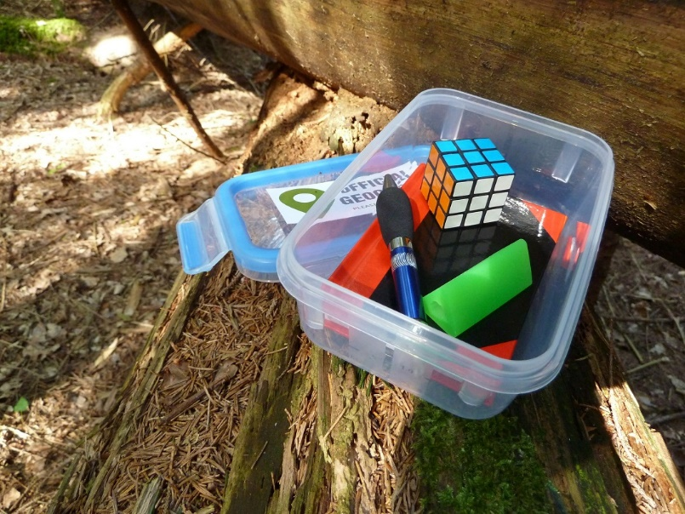
Four Steps of Hiding a Geocache
The Actual Find – Put your logbook in a waterproof bag along with a pencil and a note to welcome the cache finder.
  Preload the cache with enough prizes for the first few people to find.
  Geocaching is a family activity and the contents should be suitable for all ages.
  Do not include food items.

Slide 50

Posting a Geocache
Log onto www.geocaching.com, click on the “Play” button, choose “Hide a Geocache.”
Read through the “How to hide a geocache” articles.
When you are certain your cache meets all the requirements for placement and you have it in place, then click on the “Hide a Cache” button and fill out the form.
Before your cache is posted on Geocaching.com, a volunteer will review the cache to make sure the GPS coordinates are correct and it meets the requirements for listing.

Slide 51
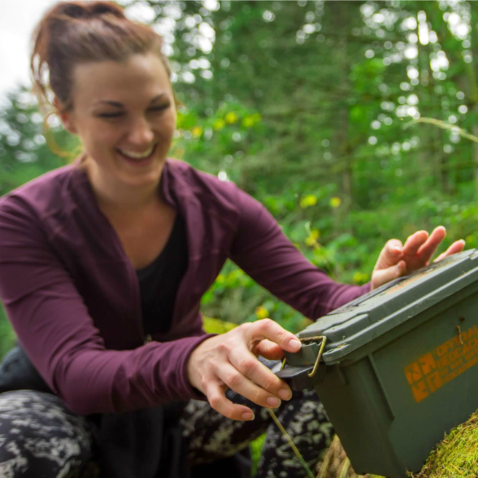
Maintaining a Geocache
Once you place a geocache, you have an obligation to maintain the cache and the area around it.
Monitor the online logs that are sent to you and act on any reports that your cache needs maintenance.
If visitors are damaging the landscape, change the location and be sure to also change the online listing.

Slide 52
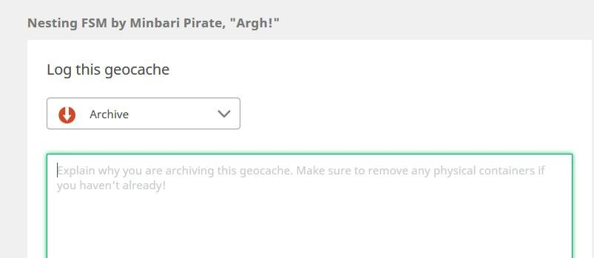
Dismantling a Geocache
Geocaches should not be placed unless you can actively maintain them for at least six months.
To dismantle the cache, physically remove the cache container and any litter that may be around your hiding spot.
Go online and archive your cache listing.

Slide 53
Requirement 2
Discuss the following with your counselor:
  Why you should never bury a cache.
  How to use proper geocaching etiquette when hiding or seeking a cache, and how to properly hide, post, maintain, and dismantle a geocache.
  The principles of Leave No Trace as they apply to geocaching.

Slide 54

Leave No Trace
Plan Ahead and Prepare
  Know and comply with the geocaching policies of the landowners or land management agencies where you wish to seek or lace caches.
  Prepare for your trip with proper equipment and clothing for the weather, terrain, and environmental conditions, and for emergencies.
  Be safe. Let someone know where you will be going and when you expect to return.
  Know how to use your GPS unit. Carry extra batteries and have a map and compass as backup.

Slide 55
Leave No Trace
Travel and Cache on Durable Surfaces
  Travel on designated trails and roads. Comply with posted signs.
  If permitted and you must travel off-trail, choose durable surfaces such as rock, sand, gravel, and dry grass, and spread out to avoid creating new paths.
  Use maps to find a route that will minimize impacts. Note way=points during your journey to assist you on your return trip.
  After you have finished searching for a cache, the area should look as though you were never there.
  Do not place a cache in sensitive locations such as fragile vegetation or soils, critical wildlife habitat, wetlands, lakeshores, alpine areas or caves.
  Do not place a cache in protected areas such as designated wilderness areas or wild and scenic river corridors, or near historic and cultural sites.
  If you notice a path has started to wear in the vicinity of a cache, notify the cache owner to move the cache.

Slide 56
Leave No Trace
Dispose of Waste Properly
  Cache In, Trash Out. Carry an extra trash bag for trash, leftover and dropped food, and litter left by others.
  Use established bathrooms when available. If not available, deposit solid human waste in catholes dug 6-8 inches deep at least 200 feet from water sources, campsites, trails, and caches.
  Pack out toilet paper and hygiene products in a double plastic bag.

Slide 57
Leave No Trace
Leave What You Find
  Preserve the past. Observe, but do not touch, cultural or historic structures and artifacts. Never use artifacts as cache items.
  Leave rocks, plants, and other natural objects for others to enjoy.
  Practice the “lift, look, replace” technique. If you lift a rock to look under it, replace it exactly as you found it.

Slide 58
Leave No Trace
Minimize Campfire Impacts
  If you plan to have a fire, know the fire regulations and current guidelines for the area you plant to visit.
  This is not often relevant for geocaching, but it is good to remember.

Slide 59
Leave No Trace
Respect Wildlife
  Observe wildlife from a distance. Do not follow or approach animals.
  Never feed wild animals. Feeding wildlife damages the animals’ health, alters natural behaviors, and exposes animals and other geocachers to predators and other dangers.
  Protect wildlife and your food by storing rations and trash securely.
  Never leave food of any kind in a cache. Wildlife may find and destroy the cache, and animals may be harmed by consuming food wrappers.
  Respect wildlife when traveling to and from cache locations. Avoid locations with significant wildlife traffic, such as water sources.
  Keep pets on a leash for their safety and the safety of wild animals. Consider leaving pets at home.

Slide 60
Leave No Trace
Be Considerate of Other Visitors
  Be courteous. Yield to other users on the trail.
  Take breaks on durable surfaces away from the trail.
  Let nature’s sounds prevail. Avoid loud voices and noises.
  Respect the rights and experiences of other visitors. Geocaching is only one of many outdoor recreational activities.
  Don’t trespass. When traveling to and from caches, take notice of private property signs.
  Practice the principles of Leave No Trace. The future of geocaching lies in the hands of geocachers.

Slide 61
Requirement 3
Explain the following terms used in geocaching: waypoint, log, cache, accuracy, difficulty and terrain ratings, attributes, trackable. Choose five additional terms to explain to your counselor.

Slide 62
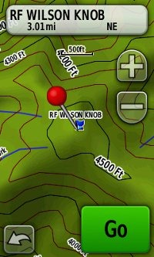
Waypoint
A Waypoint is a reference point for a physical location on Earth.
It may be a landmark, a destination, or a point along a route on the way to reaching the destination.
Waypoints are defined by a set of coordinates that typically include latitude and longitude (or UTM coordinates), and sometimes altitude.

Slide 63
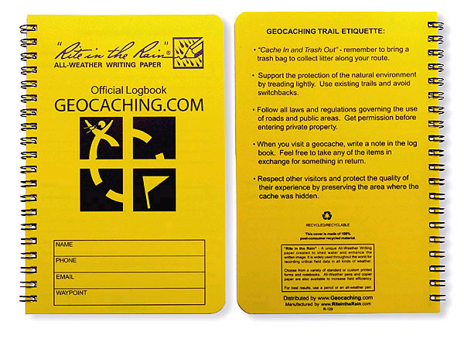
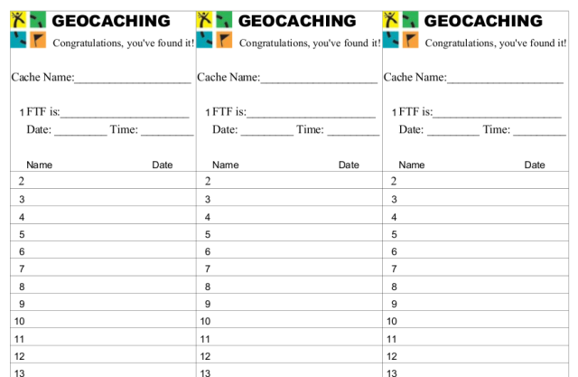
Log
The Log (logbook, notebook, or log sheet) inside a cache contains information from the cache owner and provides a place for geocachers to write their name and the date they visited the cache.
Space may also be available for visitors to write notes or leave comments for the cache owner.

Slide 64
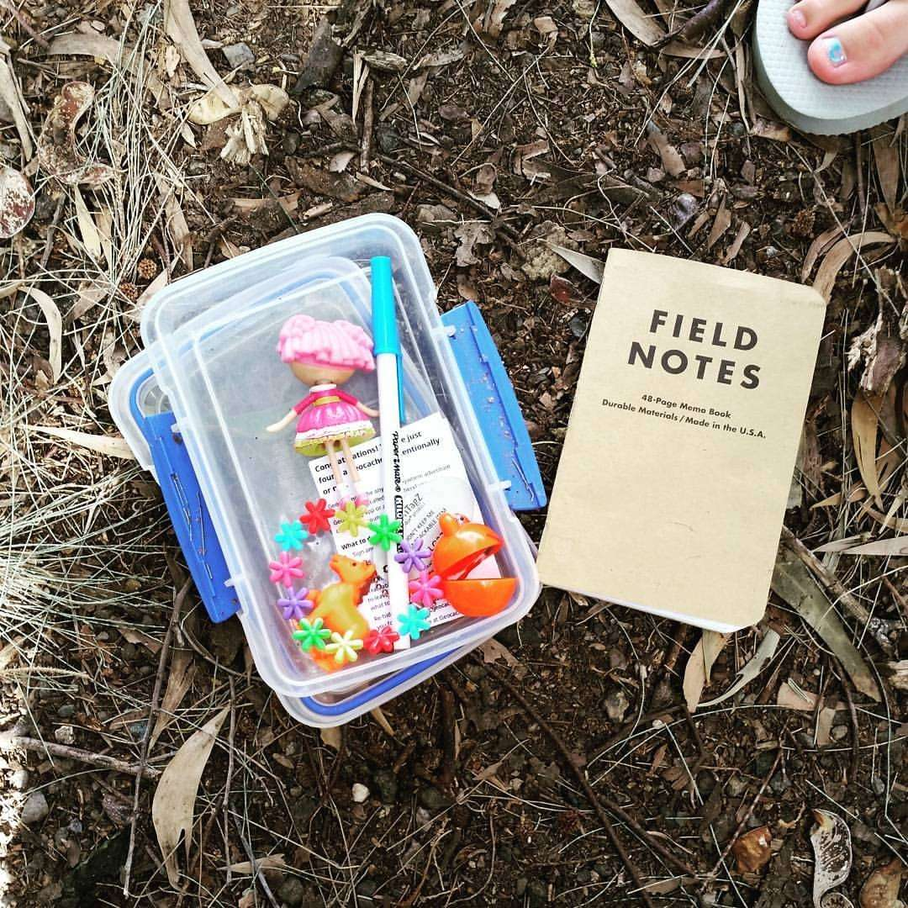
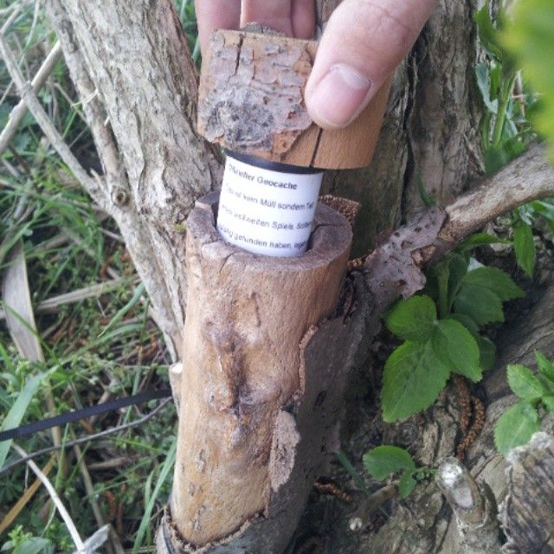
Cache and Hide
A cache, or geocache, is a container hidden at specific coordinates that includes, at a minimum, a logbook for geocachers to sign when they find the cache.
Caches may also contain “treasure,” or items to trade.
Hide is a shorthand term for a cache that is hidden.

Slide 65

Accuracy and Ground Zero
Accuracy in geocaching is the degree of closeness to the exact location.
  Neither a GPS or smartphone will give you an exact position.
  At best, you'll get an accuracy of 10 to 15 feet (3 to 5 meters
Ground Zero is the point where your GPS device shows that you have reached the exact cache location.
  In practice, you almost never reach true “ground zero.” (See accuracy.)

Slide 66
Difficulty and Terrain Ratings
Difficulty is a ranking system to describe how hard the cache is to find.
  A cache that can be found quickly is ranked 1 (easiest to find).
  A cache that is ranked 5 is exceptionally well hidden and is hardest to find.
Terrain Ratings describe the land features and how hard the cache is to get to.
  Terrain that can be traversed in a wheelchair has a rating of 1 (flat and easy and not too far.)
  A 5 rating probably means it will likely require special equipment such as scuba gear or mountaineers’ ropes.
See chart on next slide.

Slide 67


Slide 68

Attributes
Attributes are icons on a cache detail that are intended to provide helpful information to geocachers who wish to find specific types of caches.
The icons represent unique cache characteristics

Slide 69

Trackable
A Trackable is anything with a tracking number or other unique identifier that can be followed as the item travels from cache to cache.

Slide 70

Clue and Spoiler
Clues or hints give the person seeking the cache a little more information to help find it.
  The cache name, part of the description, or an official hint can all be clues.
  Examples:
    Tie Your Shoe = Bend down and look at a lower level
    Attractive = Magnetic geocache
    Troll = Under a bridge
A Spoiler is information that gives away the location of the find.

Slide 71

Being Muggled
When someone has broken into a cache and ruined it, that is called “Being Muggled.”

Slide 72

Travel Bug and Watch List
A Travel Bug is an item that travels from cache location to cache location with a trackable number written on a metal tag so you can record on the Geocaching.com website where you picked it up and where you dropped it off.
Travel Bugs often have a “mission” of getting to a certain location or state.
A Watch List is a list of users who are watching a specific Travel Bug or cache.

Slide 73

Archive
If you want to remove your cache from the public listing (or if a reviewer does this for you for lack of maintenance), it is “Archived.”
You can also temporarily disable a cache if you need to inactivate it for a short time.

Slide 74

Reviewer
Reviewers are volunteers from all over the world check new listings for various issues (making sure the cache follows the guidelines) and then publish the cache listings on Geocaching.com.

Slide 75
Acronyms
CITO – Cache In Trash Out. In this geocaching event, people do cleanup for parks or the community.
DNF – Did Not Find. Geocachers use this acronym to state that they did not find a cache. If you get several DNF responses for a cache you set up, it’s time to check on it!
FTF – First To Find. This acronym is used when logging cache finds to denote being the first to find a new geocache.
GC – Geocache Code. Each code assigned to public geocache listings is unique.
Other common acronyms often written in logs:
  TFTC – Thanks For The Cache
  TFTH – Thanks For The Hide
  TNLN – Took Nothing Left Nothing
  TNSL – Took Nothing Signed Log

Slide 76

Types of Caches
Traditional Cache – An ordinary hide with a single cache found at the given coordinates.
Multi Cache – This type of cache has more than one part. You may find the coordinates of the second cache in the first, and so on.
Mystery or Puzzle Cache – The actual cache is not at the coordinates that are listed on the website. Instead, there is a puzzle that must be solve to lead to the actual site.

Slide 77

Types of Caches
Letterboxing (www.letterboxing.org) – A form of treasure hunting that uses clues to direct the seekers to a hidden container. Each container has a unique stamp that you use to mark your logbook and you leave your own unique stamp in the letterbox logbook. Do not take the stamp from the letterbox.

Slide 78
Requirement 4
Explain how the Global Positioning System (GPS) works. Then, using Scouting's teaching EDGE, demonstrate the use of a GPS unit to your counselor. Include marking and editing a waypoint, changing field functions, and changing the coordinate system in the unit.

Slide 79
How Does the GPS System Work?
A GPS receiver calculates its position by carefully timing the signals sent by the 31 orbiting GPS satellites.
Each satellite continually transmits data that indicates its location and the current time.
All GPS satellites transmit signals at the same instant, but the signals arrive at a GPS receiver at slightly different times.
  The farther the receiver is from a satellite, the longer the signal takes to reach the receiver.
  The receiver uses the arrival time of each signal to measure the distance to each satellite.
Once the receiver has detected signals from a minimum of 4 satellites, the GPS unit can calculate the receiver’s location and altitude.
The more satellites the receiver tracks and acquires, the better the accuracy.

Slide 80


Slide 81

GPS Signal Obstruction
Tall buildings, trees, tunnels, canyons, mountains, clothing, and the human body can interrupt satellite signals, slowing them down and reducing your device's accuracy.
Clouds and weather, however, shouldn't affect reception.
When possible, put a GPS receiver in a place where it has a clear and unobstructed view of a large portion of the sky.

Slide 82

GPS Accuracy
A common error for beginning geocachers is to try to get the number in the GPS “distance” field to go to zero.
Most modern GPS units can be accurate to 3-meters (10 feet) or less.
Modern smartphones, in contrast, offer GPS accuracy of around 4.9 meters (16 feet) .
Searching for “ground zero” or the exact final spot is required in most cases.

Slide 83

Using a GPS Receiver
To list all the functions of every GPS receiver on the market would be difficult.
This overview covers the basic functions of generic GPS receivers.
Each GPS unit comes with it own detailed instructions to help you.

Slide 84

Basic Functions of a GPS Receiver
Basic geocaching will require you to be able to switch between different function screens, to enter coordinates, to mark a waypoint, and to know how to use the compass screen and its data fields.
Locate the device’s on/off button.
Next learn where the battery-level indicator is and how to recharge or change the batteries.
  Always carry an extra set of fresh batteries, just in case.

Slide 85

Basic Functions of a GPS Receiver
NAV (navigation) or PAGE Button
  The means to change from screen to screen.
  i.e. satellites acquired, compass, map display
ENTER Button
  Allows you to select an option or menu choice.
ESCAPE, QUIT, or BACK Button
  Used to leave the screen you are on and return to the previous screen and function.
UP, DOWN, LEFT, and RIGHT Buttons
  Allows you move around the various functions or menus to accomplish tasks.

Slide 86
Basic Functions of a GPS Receiver
MARK Button
  Records where you are.
ZOOM Buttons
  Allows you to zoom in or out while viewing the map screen.
MENU Button
  Displays a list of options for functions and configurations that allow customizing the GPS receiver.
GOTO or FIND Button
  Lets you search your programmed waypoints or geocache locations that are stored in the GPS unit’s memory.

Slide 87
Requirement 5
Do the following:
  Show you know how to use a map and compass and explain why this is important for geocaching.
  Explain the similarities and differences between GPS navigation and standard map reading skills and describe the benefits of each.

Slide 88

Map and Compass
Why do you need to know how to use a map and compass when the GPS receiver’s arrow tells you where to go?
  The GPS unit can, and will fail.
  It won’t tell you what is between you and your objective.
  Batteries may die.
  You may be in a location where you can’t get a good signal.
  You might accidentally program in the wrong coordinates and be heading in the wrong direction.

Slide 89

Topographic Maps
Topographic maps use contour lines to show elevation and colors to represent water, forested areas, roads, and other features.
A topographic map provides precise details and a large view of the area to better map out your route.
  Most GPS receivers offer the option to upload topographic maps directly to the unit.
  Due to screen size, you can view a large area with little detail or a small area with great detail.

Slide 90

Latitude and Longitude
Lines of Latitude or parallels, circle the globe in a horizontal direction and measure north-south position between the poles.
  The equator is defined as 0 degrees, the North Pole is 90 degrees north, and the South Pole is 90 degrees south.
Lines of Longitude, or meridians, run vertically, dividing Earth into segments that meet at the North and South Poles.
  Meridians measure east-west position.
  The prime meridian, which runs through Greenwich, England is assigned the value of 0 degrees.
  Meridians to the west of the prime meridian are measured in degrees west; those to the east of the prime meridian are measured in degrees east.

Slide 91
Latitude and Longitude
To show precise locations, each degree of longitude and latitude is divided into 60 minutes.
Each minute of longitude and latitude is divided into 60 seconds.
Symbols used for these units of measure:
  ^{O} = degrees, ′ = minutes, ″ = seconds
A position on the globe is started latitude first, followed by longitude.
  i.e. The coordinates of latitude and longitude for the summit of Baldy Mountain in New Mexico is 36^{O}37′45″N, 105^{O}12′48″W.

Slide 92

7.5 Minute Topographic Map
Topographical maps contain longitude and latitude values, expressed in degrees, minutes and seconds.
In this sample map, the right hand longitude is listed as 121 degrees, 30 minutes, and 0 seconds (zero is assumed and not explicitly printed).
  The upper left corner (not shown) lists 121 degrees, 37 minutes, and 30 seconds.
  The difference between the right and left edges of the map is 7 minutes and 30 seconds (or 7.5 minutes).
In the upper right hand corner the latitude is listed as 37 degrees, 37 minutes, and 30 seconds.
  The lower right hand corner (not shown) lists 37 degrees, 30 minutes, and 0 seconds.
  Again, 7.5 minutes of latitude between the bottom and top of the map.

Slide 93
Common Formats for Latitude and Longitude
Degrees, Minutes, and Seconds (DDD^{O} MM′ SSSS″)
  The most common format used to mark topographic maps.
  BSA national office is at 32^{O} 53′ 08.72″ N, 096^{O} 58′ 13.13″ W.
Degrees and Decimal Minutes (DDD^{O} MM.MMM′)
  The format most commonly used with GPS devices and Geocach.com.
  BSA national office is at 32^{O} 53.137 N, 096^{O} 58.218′ W.
Decimal Degrees (DDD.DDDDD^{O})
  The format most commonly used with computer-based mapping systems display.
  Positive values are for latitudes North of the equator and East longitudes.
  Negative values are for latitudes South of the equator and West longitudes.
  BSA national office is at 32.88563, -096.97031.

Slide 94
Requirement 5
Do the following:
  Show you know how to use a map and compass and explain why this is important for geocaching.
  Explain the similarities and differences between GPS navigation and standard map reading skills and describe the benefits of each.

Slide 95
Characteristics | Compass | GPS
Cost | Low | High
Dependability | Compasses can give false readings, but these can usually be avoided with care. Keep the compass away from all metal objects since these can deflect the magnetic needle. Many geological formations and rocks are magnetized and can affect compass readings, as can electricity power lines and cables. | A GPS requires a strong signal to work accurately. It won't receive a signal inside most buildings or in caves and sometimes under heavy forest cover or even just a cloudy day. Batteries can run out.
Display | A compass must be used with a large paper map, which helps give an area a broad geographical context. | GPS displays are too small to give you a good sense of geographic context.
Ease of use | Using a map and compass requires a higher level of navigational skill and understanding. | An electronic device that demands a lower level of navigational understanding, although extensive training is required to use to its full advantage. Easier to use than a traditional map and compass when walking.
Range of functions | Without a map, a compass only shows you north. | Can store a range of maps and can pinpoint exactly where you are on a map. It will let you know how much distance you've covered and how much further you have to go. It can also estimate your altitude.
Risk of breakage | Simple and robust technology with a very low risk of breakage. | It can break or stop working if you drop it or if it gets wet.
Weight | Lightweight | Heavier and more bulky. Spare batteries must be carried.

Slide 96
GPS Versus Map Navigation
A GPS unit provides far more detailed navigational information than a compass, although the navigational understanding required is more superficial.
Using a compass with a map gives a broader geographical context, helps you remember the route and learn about other things on the way.
A compass and map are more reliable but require a higher level of navigational skill and understanding and should always be carried on a trek.
Both compliment each other and help make up for the other’s shortfalls.

Slide 97
Requirement 6
Describe the four steps to finding your first cache to your counselor. Then mark and edit a waypoint.

Slide 98

Finding Your First Cache
Step 1 – Research
Go to www.geocaching.com and register for a free basic membership.
To locate the geocaches nearest you, enter your zip code and click the search icon.
  The list will tell you:
  How far away a cache is.
  What type of cache it is.
  How difficult it is to find.
  How difficult the terrain is.
Choose a geocache from the list and click on its name.
Enter the coordinates of the geocache into your GPS device.
You will need the right maps to help you search.
  A road map may be appropriate for an urban cache.
  A topographical map may be necessary for a rural cache for terrain details.

Slide 99

Finding Your First Cache
Step 2 – Safety
Before you head out, be sure to tell someone where you are going and when you expect to return.
Use the buddy system.
Pack your pack.
Bring a personal first-aid kit, a compass, maps, and extra batteries for your GPS receiver.
Bring water and food.
Pack extra clothing appropriate for the weather.

Slide 100

Finding Your First Cache
Step 3 – The Hunt
Mark your starting place as a waypoint to guide your return.
Use your GPS device to help you find the geocache.
From your research, you should know the best approach for getting near the cache.
As you get closer to the final location, don’t rely too much on the GPS pointer arrow, but rather concentrate more on the overall distance decreasing.
The final 30 feet can be the most difficult.
At this stage, look around for likely hiding spots and remember, a cache may be cleverly hidden and camouflaged.

Slide 101

Finding Your First Cache
Step 4 – The Actual Find
Sign the cache’s logbook with your name or “handle, the date, and a few words about your experience.
Caches often have prizes inside to be traded.
  If you trade for items, leave an item of at least equal value to what you take.
Use the waypoint you created to guide your return.
When you get home, log your visit online by going back to the cache’s page at Geocaching.com.

Slide 102
Requirement 7
With your parent's permission*, go to www.geocaching.com. Type in your city and state to locate public geocaches in your area. Share the posted information about three of those geocaches with your counselor. Then, pick one of the three and find the cache.
*To fulfill this requirement, you will need to set up a free user account with www.geocaching.com. Ask your parent for permission and help before you do so.

Slide 103

Geocaching.com
www.geocaching.com is the most popular website for the public sport of geocaching.
The site has more than a million active caches and has hundreds of thousands of users worldwide.
Basic membership is free, but for a small yearly fee, you can get the bonus features of a premium membership.
After logging in, go to the Help Center as there are several topics that are must-reads for beginning geocachers.
All caches posted on Geocaching.com adhere to their guidelines and are confirmed by volunteer reviewers.

Slide 104
Requirement 8
Do ONE of the following:
  If a Cache to Eagle® series exists in your council, visit at least three of the 12 locations in the series. Describe the projects that each cache you visit highlights, and explain how the Cache to Eagle® program helps share our Scouting service with the public.
  Create a Scouting-related Travel Bug® that promotes one of the values of Scouting. "Release" your Travel Bug into a public geocache and, with your parent's permission, monitor its progress at www.geocaching.com for 30 days. Keep a log, and share this with your counselor at the end of the 30-day period.
  Set up and hide a public geocache, following the guidelines in the Geocaching merit badge pamphlet. Before doing so, share with your counselor a three-month maintenance plan for the geocache where you are personally responsible for those three months. After setting up the geocache, with your parent’s permission, follow the logs online for 30 days and share them with your counselor. You must archive the geocache when you are no longer maintaining it.
  Explain what Cache In Trash Out (CITO) means, and describe how you have practiced CITO at public geocaches or at a CITO event. Then, either create CITO containers to leave at public caches, or host a CITO event for your unit or for the public.

Slide 105

Cache to Eagle
Cache to Eagle is a series of public geocaches that have been set up at the sites of Eagle Scout Service projects.
Contact your local council to see if they have set up a Cache to Eagle Program.

Slide 106
Requirement 8
Do ONE of the following:
  If a Cache to Eagle® series exists in your council, visit at least three of the 12 locations in the series. Describe the projects that each cache you visit highlights, and explain how the Cache to Eagle® program helps share our Scouting service with the public.
  Create a Scouting-related Travel Bug® that promotes one of the values of Scouting. "Release" your Travel Bug into a public geocache and, with your parent's permission, monitor its progress at www.geocaching.com for 30 days. Keep a log, and share this with your counselor at the end of the 30-day period.
  Set up and hide a public geocache, following the guidelines in the Geocaching merit badge pamphlet. Before doing so, share with your counselor a three-month maintenance plan for the geocache where you are personally responsible for those three months. After setting up the geocache, with your parent’s permission, follow the logs online for 30 days and share them with your counselor. You must archive the geocache when you are no longer maintaining it.
  Explain what Cache In Trash Out (CITO) means, and describe how you have practiced CITO at public geocaches or at a CITO event. Then, either create CITO containers to leave at public caches, or host a CITO event for your unit or for the public.

Slide 107

Travel Bugs
Travel Bugs are a main trackable item that can be purchased through Geocaching.com.
Travel Bugs are like dog tags with a unique code that you can attach to any item of your choice.
Travel Bugs at Geocaching.com have a page with the object’s mission (what the owner wants to have happen with the traveling object).
Miles traveled are logged and the person who moves it to a new cache posts a note about it on the Geocaching.com site.

Slide 108
Requirement 8
Do ONE of the following:
  If a Cache to Eagle® series exists in your council, visit at least three of the 12 locations in the series. Describe the projects that each cache you visit highlights, and explain how the Cache to Eagle® program helps share our Scouting service with the public.
  Create a Scouting-related Travel Bug® that promotes one of the values of Scouting. "Release" your Travel Bug into a public geocache and, with your parent's permission, monitor its progress at www.geocaching.com for 30 days. Keep a log, and share this with your counselor at the end of the 30-day period.
  Set up and hide a public geocache, following the guidelines in the Geocaching merit badge pamphlet. Before doing so, share with your counselor a three-month maintenance plan for the geocache where you are personally responsible for those three months. After setting up the geocache, with your parent’s permission, follow the logs online for 30 days and share them with your counselor. You must archive the geocache when you are no longer maintaining it.
  Explain what Cache In Trash Out (CITO) means, and describe how you have practiced CITO at public geocaches or at a CITO event. Then, either create CITO containers to leave at public caches, or host a CITO event for your unit or for the public.

Slide 109
Setting Up Your Own Geocaches
Follow the rules when you place your own cache.
Complete geocaching guidelines for Geocaching.com are at https://www.geocaching.com/play/guidelines.
The guidelines cover safety rules as well as environmental concerns.
Geocaching.com also has a quick guide to hiding your first geocache at https://www.geocaching.com/play/hide.

Slide 110
Requirement 8
Do ONE of the following:
  If a Cache to Eagle® series exists in your council, visit at least three of the 12 locations in the series. Describe the projects that each cache you visit highlights, and explain how the Cache to Eagle® program helps share our Scouting service with the public.
  Create a Scouting-related Travel Bug® that promotes one of the values of Scouting. "Release" your Travel Bug into a public geocache and, with your parent's permission, monitor its progress at www.geocaching.com for 30 days. Keep a log, and share this with your counselor at the end of the 30-day period.
  Set up and hide a public geocache, following the guidelines in the Geocaching merit badge pamphlet. Before doing so, share with your counselor a three-month maintenance plan for the geocache where you are personally responsible for those three months. After setting up the geocache, with your parent’s permission, follow the logs online for 30 days and share them with your counselor. You must archive the geocache when you are no longer maintaining it.
  Explain what Cache In Trash Out (CITO) means, and describe how you have practiced CITO at public geocaches or at a CITO event. Then, either create CITO containers to leave at public caches, or host a CITO event for your unit or for the public.

Slide 111

Cache In Trash Out (CITO)
The Cache In Trash Out program is a way for geocachers to repay the public parks and other locations for allowing geocaching on their property.
The easiest way to use CITO is to carry a trash bag with you whenever you geocache and use it to clean up the areas where the caches are located.
You can also organize a community CITO event.
  A community service project in which public geocachers work side by side with Scouts.
  Work with an agency or a community organization to decide on a good service project.
  Then create an event listing on Geocaching.com
DIPO - Dog In Poop Out
  Make sure you clean up after your pets!

Slide 112

Making CITO Containers
Old film canisters make great CITO containers.
  Place trash bags inside them to leave in geocaches.
  Create custom decorated CITO labels for the containers.
These containers can move from cache to cache.
People pick up the container, use the bag inside to clean up the immediate are, and then replace the bag with a clean one form home and drop off the container at the next cache they find.

Slide 113
Requirement 9
Plan a geohunt for a youth group such as your troop or a neighboring pack, at school, or your place of worship. Choose a theme, set up a course with at least four waypoints, teach the players how to use a GPS unit, and play the game. Tell your counselor about your experience, and share the materials you used and developed for this event.

Slide 114
How to Plan and Run a Geocaching Game
Plan ahead. Decide what the game is for, who will take part, where it will be, what safety precautions must be followed, what you need to set up the game, and how you will clean up after the game.
Get any permissions that are needed, including permission slips for the youth participants, permission from the property owner, and the permission of your senior patrol leader, Scoutmaster, or Troop Committee.
Set up the game ahead of time. Design and load the appropriate number of cache containers for your game and hide them before people arrive.
Have clear rules and objectives for your game. Be sure each participant understands the safety rules and the principles of Leave No Trace.
Play the game!
Afterward, debrief the activity (explain what the game was about.)
Clean up the area and be sure to pick up all cache containers from their hiding places.
Download the form “Planning a Geohunt for a Youth Group” to help you plan this activity.

Slide 115



Theme Ideas
Scout Rank Advancement
Path to Eagle
Pirates
Star Wars
Pokémon
Raiders of the Lost Arc
Town History

